Slide 1

EmpData Analysis using Excel
STUDENT NAME:HEMANTH KUMAR S
REGISTER NO: 440E4A1F0BCFE64B583491BE15E38011
DEPARTMENT: BCOM(CORPORATE SECRETARYSHIP)
COLLEGE: DON BOSCO ARTS & SCIENCE COLLEGE, CHENNAI
Notes:
null

Slide 2

PROJECT TITLE
Current Employee Rating Analysis using Excel

Slide 3



AGENDA
Problem Statement
Project Overview
End Users
Our Solution and Proposition
Dataset Description
Modelling Approach
Results and Discussion
Conclusion
3/21/2024 Annual Review

Slide 4

PROBLEM STATEMENT
The problem at hand involves analyzing the current employee performance ratings using Excel to identify trends, inconsistencies, and areas for improvement. The objective is to assess individual and team performance, ensuring the evaluation criteria are fair and aligned with organizational goals. This analysis will involve comparing ratings across different departments, roles, and time periods, identifying top performers, and detecting any rating patterns or biases that might affect employee development or compensation decisions. By utilizing Excel's data analysis tools, such as pivot tables, charts, and statistical functions, the goal is to provide actionable insights that can enhance the performance evaluation process and drive employee engagement and productivity..

Slide 5

PROJECT OVERVIEW
Total Employees: The dataset includes 1,038 employees across various business units.
Average Ratings: The overall average employee rating across all units is approximately 2.95.
Top and Bottom Units:
Highest Average Rating: SVG (3.03)
Lowest Average Rating: TNS (2.79)

Slide 6

WHO ARE THE END USERS?
1. Human Resources (HR).
2. Management and Leadership.
3. Employee Development Teams.
4. Business Unit Heads.
5. Analytics and Strategy Teams.
6. Compensation and Benefits Teams.
7. Employee Engagement Committees.
8. Talent Acquisition Teams.
9. Legal and Compliance Departments.
10. Board of Directors or Executive Committee.
11. Financial Planning and Analysis (FP&A) Teams.
12. IT and Data Analytics Teams.
13. Firms and Industry.

Slide 7

OUR SOLUTION AND ITS VALUE PROPOSITION
Filtering: To focus on targeted analysis, remove error reduction,customization etc.
Conditional formatting: To visual insights,quick analysis,error detection,focus on priorities.
Pivot Table & Graphs: Data Summarization,Filtering and Sorting,CrossTabulation,Flexibility,Data Visualization,Interactive Analysis,Multiple Chart Types,Enhanced Communication.

Slide 8
Dataset Description
Employee data set- Kaggle
Features:
Employment ID
Gender- male,female
Performance
Busniess Unit
Name
Rating
Graphs
Chart

Slide 9

THE "WOW" IN OUR SOLUTION
Features and Functionality in my Dataset:
1. Data Summarization
2. Aggregation
3. Category Breakdown
4. Rating Distribution
3/21/2024 Annual Review

Slide 10
MODELLING
Descriptive Analytics
Predictive Modeling
Regression Analysis
Clustering
Classification
Time Series Analysis
Decision Trees

Slide 11
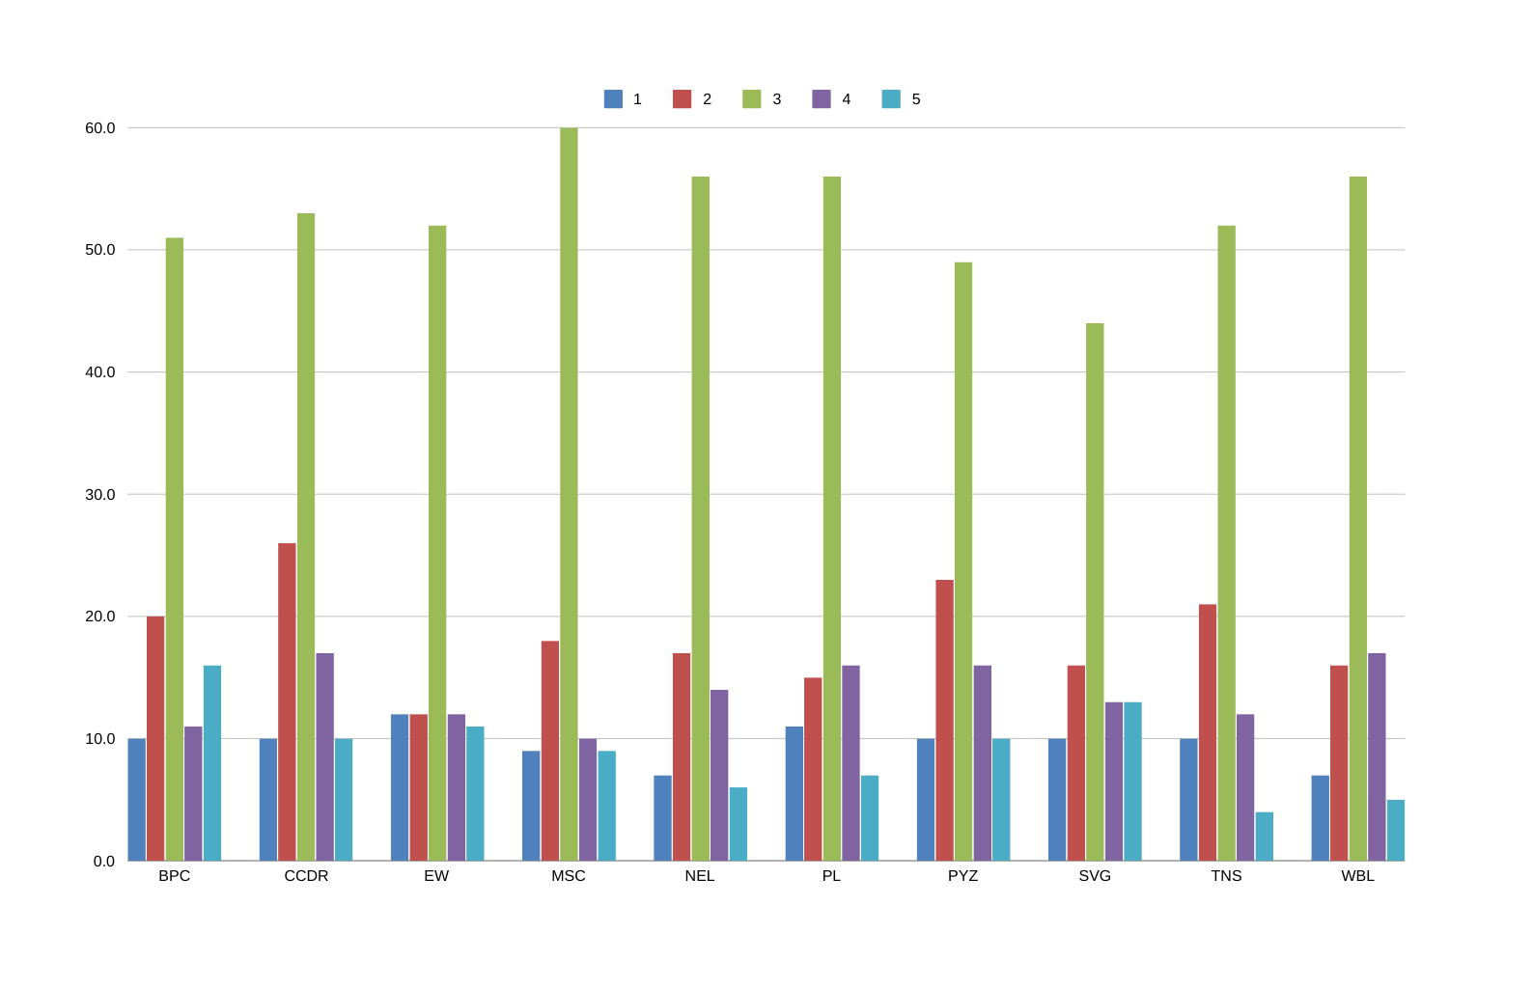
RESULTS

Slide 12
conclusion
The current employee rating analysis reveals variability in ratings across different business units, suggesting differences in performance or evaluation standards. However, the dataset's inconsistencies, including missing values and structural issues, may impact the reliability of these insights. To draw more accurate conclusions, the data requires cleaning and proper formatting. Once addressed, a more detailed analysis could pinpoint specific areas of strength or concern, guiding potential performance improvements or targeted interventions within the organization.

